Slide 1
Information Extraction: extracting Named Entities and Relations from text
Based on a presentation by Diana Maynard
Natural Language Processing Group
University of Sheffield, UK

Slide 2

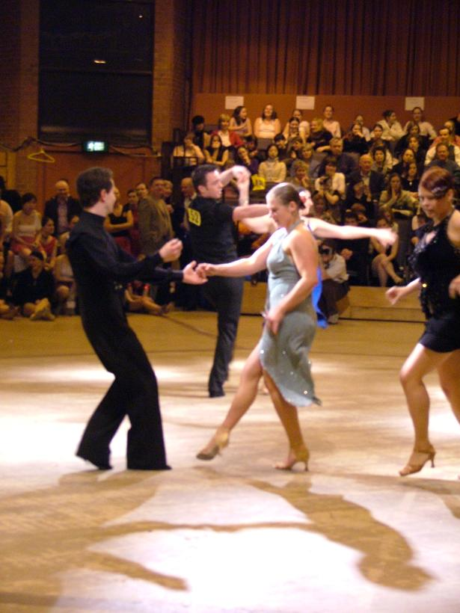
Diana Maynard

Slide 3
Outline
Information Extraction applications
Knowledge Engineering v ML
Rule-based Named Entity Recognition
MUSE MUlti-Source Entity recognition
Research in Information Extraction

Slide 4
IE is not IR
IR pulls documents from large text collections (e.g. “google search” the Web) in response to specific keywords or queries. You analyse the documents.
IE pulls facts and structured information (Named Entities and Relations) from the content of large text collections (e.g corpora). You analyse the facts.

Slide 5
IE for Document Access
With traditional query engines, getting the facts can be hard and slow
Where has the Queen visited in the last year?
Which places on the East Coast of the US have had cases of West Nile Virus?
Which search terms would you use to get this kind of information?
IE would return information in a structured way
IR would return documents containing the relevant information somewhere (if you were lucky)

Slide 6
IE as an alternative to IR
IE returns knowledge at a deeper level than IR
Constructing a database through IE and linking it back to the documents can provide a valuable alternative search tool.
Even if results are not always accurate, they can be valuable if linked back to the original text

Slide 7
When would you use IE?
For access to news
identify major relations and event types (e.g. within foreign affairs or business news)
For access to scientific reports
identify principal relations of a scientific subfield (e.g. pharmacology, genomics)

Slide 8
Application 1 – HaSIE
Aims to find out how companies report about health and safety information
Answers questions such as:
“how many members of staff died or had accidents in the last year?”
“is there anyone responsible for health and safety”
“what measures have been put in place to improve health and safety in the workplace?”

Slide 9
HASIE
Identification of such information is too time-consuming and arduous to be done manually
IR systems can’t cope with this because they return whole documents, which could be hundreds of pages
System identifies relevant sections of each document, pulls out sentences about health and safety issues, and populates a database with relevant information

Slide 10
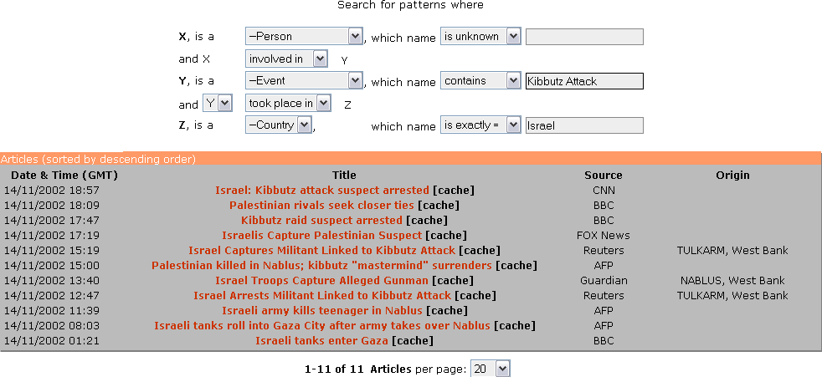
Application 2: KIM
Ontotext’s KIM query and results

Slide 11
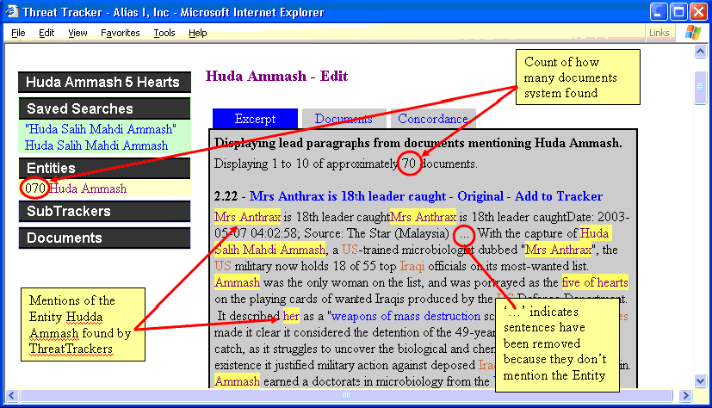
Application 3: Threat tracker

Slide 12
What is Named Entity Recognition?
Identification of proper names in texts, and their classification into a set of predefined categories of interest
Persons
Organisations (companies, government organisations, committees, etc)
Locations (cities, countries, rivers, etc)
Date and time expressions
Various other types as appropriate

Slide 13
Why is NER important
NER provides a foundation from which to build more complex IE systems
Relations between NEs can provide tracking, ontological information and scenario building
Tracking co-reference “Dr Anthrax, Huda, she”
Ontologies “Person, Event, Country”
Relations “Dr Head became the new director of Shiny Rockets Corp”

Slide 14
Two kinds of approaches (to IE, and to other NLP, eg PoS-tagger)
Knowledge Engineering
“hand-crafted” rule-based system
developed by experienced knowledge engineers
makes use of human intuition
requires only small amount of example training data
may not require high performance computing
development can be time consuming
some changes may require checking entire rule set
Machine Learning
use statistical language models and machine learning
developers do not need domain expertise
requires large amounts of annotated training data
requires high performance computing: processor, memory
some changes may require re-annotation of the entire training corpus

Slide 15
Basic Problems in Named Entity Recognition
Variation of NEs – e.g. John Smith, Mr Smith, John.
Ambiguity of NE types: John Smith (company vs. person)
June (person vs. month)
Washington (person vs. location)
1945 (date vs. time)
Ambiguity between common words and proper nouns, e.g. “may”

Slide 16
Complex problems in NER
Issues of style, structure, domain, genre etc.
Punctuation, spelling, spacing, formatting
Dept. of Computing and Maths
Manchester Metropolitan University
Manchester
United Kingdom
> Tell me more about Leonardo
> Da Vinci

Slide 17
List lookup approach - baseline
System that recognises only entities stored in its lists (gazetteers).
Advantages - Simple, fast, language independent, easy to retarget (just create new lists)
Disadvantages - collection and maintenance of lists, cannot deal with name variants, cannot resolve ambiguity

Slide 18
Shallow Parsing Approach (internal structure)
Internal evidence – names often have internal structure. These components can be either stored or guessed, e.g. location:
Cap. Word + {City, Forest, Center, River}
e.g. Sherwood Forest
Cap. Word + {Street, Boulevard, Avenue, Crescent, Road}
e.g. Portobello Street

Slide 19
Problems with the shallow parsing approach
Ambiguously capitalised words (first word in sentence) [All American Bank] vs. All [State Police]
Semantic ambiguity "John F. Kennedy" = airport (location) "Philip Morris" = organisation
Structural ambiguity [Cable and Wireless] vs.
[Microsoft] and [Dell]
[Center for Computational Linguistics] vs.
message from [City Hospital] for [John Smith]

Slide 20
Shallow Parsing Approach with Context
Use of context-based patterns is helpful in ambiguous cases
"David Walton" and "Goldman Sachs" are indistinguishable
But with the phrase "David Walton of Goldman Sachs" and the Person entity "David Walton" recognised, we can use the pattern "[Person] of [Organization]" to identify "Goldman Sachs“ correctly.

Slide 21
Identification of Contextual Information
Use KWIC concordance eg SketchEngine to find windows of context around entities
Search for repeated contextual patterns of entities
Manually post-edit list of patterns, and incorporate useful patterns into new rules
Repeat with new entities

Slide 22
Examples of semantic patterns with entity types and relations
[PERSON] earns [MONEY]
[PERSON] joined [ORGANIZATION]
[PERSON] left [ORGANIZATION]
[PERSON] joined [ORGANIZATION] as [JOBTITLE]
[ORGANIZATION]'s [JOBTITLE] [PERSON]
[ORGANIZATION] [JOBTITLE] [PERSON]
the [ORGANIZATION] [JOBTITLE]
part of the [ORGANIZATION]
[ORGANIZATION] headquarters in [LOCATION]
price of [ORGANIZATION]
sale of [ORGANIZATION]
investors in [ORGANIZATION]
[ORGANIZATION] is worth [MONEY]
[JOBTITLE] [PERSON]
[PERSON], [JOBTITLE]

Slide 23
MUSE – MUlti-Source Entity Recognition
An IE system developed within GATE General Architecture for Text Engineering https://gate.ac.uk/
Performs NE and coreference on different text types and genres
Uses knowledge engineering approach with hand-crafted rules
Performance rivals that of machine learning methods

Slide 24
MUSE Modules
Document format and genre analysis
Tokenisation
Sentence splitting
POS tagging (Verb, Adjective, Noun, ProperNoun)
Gazetteer lookup (NE dictionaries)
Semantic grammar ([PERSON] earns [MONEY])
Name coreference (Mr Smith, John)
Pronoun coreference (John, he)

Slide 25
Multilingual MUSE
MUSE has been adapted to deal with different languages: English, French, German, Romanian, Bulgarian, Russian, Cebuano, Hindi, Chinese, Arabic, …
Separation of language-dependent and language-independent modules and sub-modules makes adaptation easier.

Slide 26
IE in Surprise Languages
Adaptation to an unknown language in a very short timespan
Cebuano:
Latin script, capitalisation, words are spaced
Few resources and little work already done
Medium difficulty
Hindi:
Non-Latin script, different encodings used, no capitalisation, words are spaced
Many resources available
Medium difficulty

Slide 27
What does multilingual NER require?
Extensive support for non-Latin scripts and text encodings, including conversion utilities
Takes up to 2/3 of the effort
Bilingual dictionaries
Annotated corpus for evaluation
Internet resources for gazetteer list collection (e.g., phone books, yellow pages, bi-lingual pages)

Slide 28
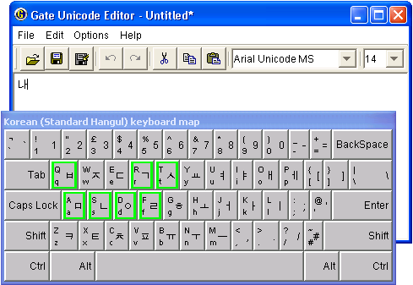
Editing Multilingual Data
GATE Unicode Kit (GUK)
Complements Java’s facilities
Support for defining Input Methods (IMs)
currently 30 IMs for 17 languages
Pluggable in other applications (e.g. JEdit)

Slide 29
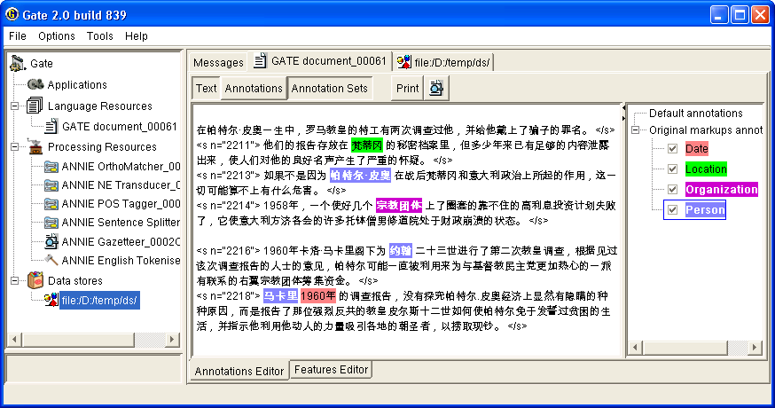
Processing Multilingual Data
All processing, visualisation and editing tools use GUK

Slide 30
Research in Information Extraction
Tools for semantic web
Need for IE in bioinformatics and medicine
IE for finance, eg IE from news to predict share prices
Cross fertilisation of IE and IR , eg. Question Answering
Relations between entities
see Jurafsky and Martin textbook

Slide 31
Summary
Information Extraction: extracting Named Entities and Relations from text
Information Extraction applications
Knowledge Engineering v ML
Rule-based Named Entity Recognition
MUSE MUlti-Source Entity recognition
Research in Information Extraction

